Slide 1
Winter Winning Camp
DATABASE MANAGEMENT SYSTEM
Department Of Career Planning & Development

Slide 2
List the Products Ordered in a Period
Ques 1 You are given two tables:
Products: product details
Orders: units ordered on different dates
Your task:
Find product names whose total ordered units in February 2020 (2020-02-01 to 2020-02-29) are at least 100, and also show their total units.

Slide 3
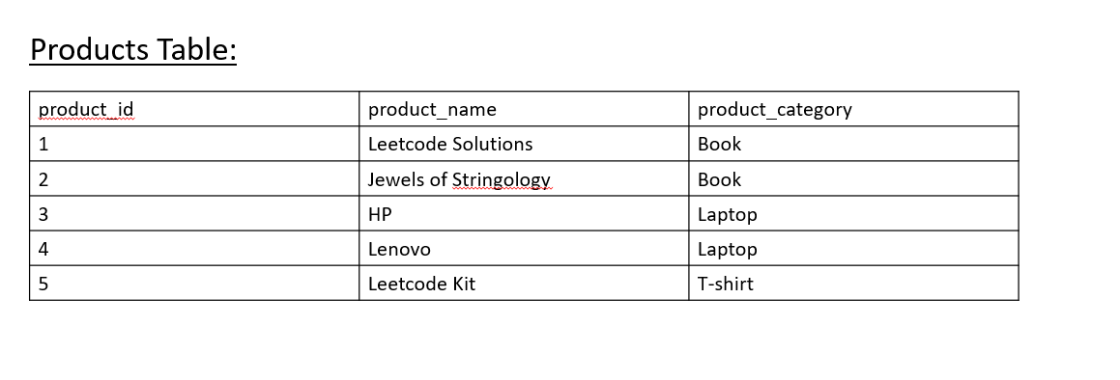

Slide 4
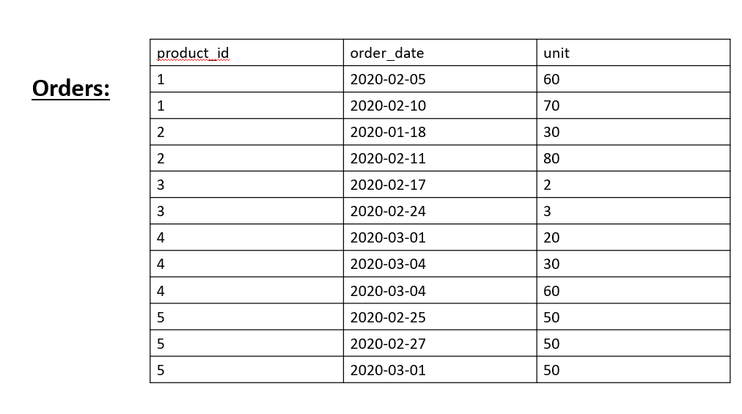

Slide 5
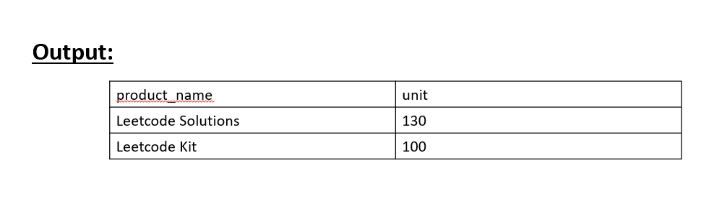

Slide 6
Exclusive Join
An exclusive join returns rows from one table that have no match in another table.
Or
“Give me all rows in Table A that don’t exist in Table B.”

Slide 7
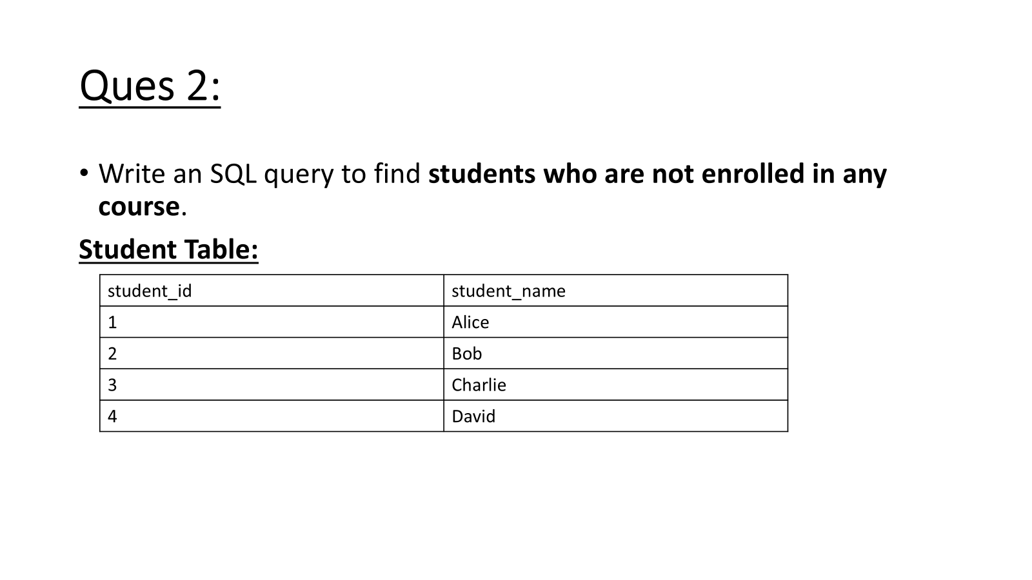

Slide 8
